Slide 1
A Journey of Excellence
RUW is proudly celebrating
10 years of operation

Slide 2
Some of the Achievements
RUW started its operations in 2005 and the major achievements are:
RUW received Her Royal Highness Princess Shaikha Sabeeka Bint Ebrahim Al Khalifa award for Bahraini Women Empowerment for the year 2014.
RUW is the first university to meet the newly established HEC accreditation and received a very positive report.
RUW is one of the first two universities listed on National Qualifications Framework.

Slide 3
Some of the Achievements
CBFS received ‘Confidence’ in all three programmes in the Programmes-within-College review held in 2014 and recently received the validation of the NQF mapping of two of its programmes.
RUW Bachelor of Law programme reviewed by University of Cambridge
RUW hosted the MENA Moot court competition and our team came 3rd from 15 teams.
RUW Achieved 6 Medals in Bahrain National Skills Competition in fashion design and graphic design.

Slide 4
Programmes at RUW
In recent years RUW has expanded its curriculum offerings by implementing new programmes such as:
Bachelor of Business in Marketing
B.Arch. in Architectural Design
Master of Design Management
Master of Fine Art in Drawing and painting
Bachelor of Law

Slide 5
Colleges at RUW
College of Art and Design
College of Business and Financial Sciences
College of Information Technology
College of Law
Center for General Studies

Slide 6
Conference Themes
Over the next 2 days this conference will be exploring many themes such as :
Women in Business and Leadership
Women in Innovation and Technology
Women and legislation and human rights
Women in Art & Design
Women across cultures

Slide 7
GRADUATION STATISTICS AY 2008-09 TILL AY 2015-16

Slide 8
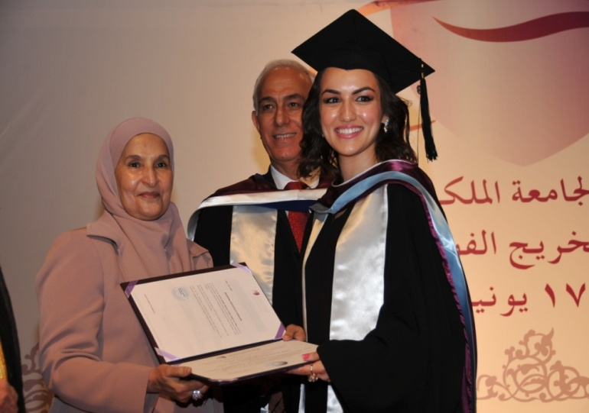
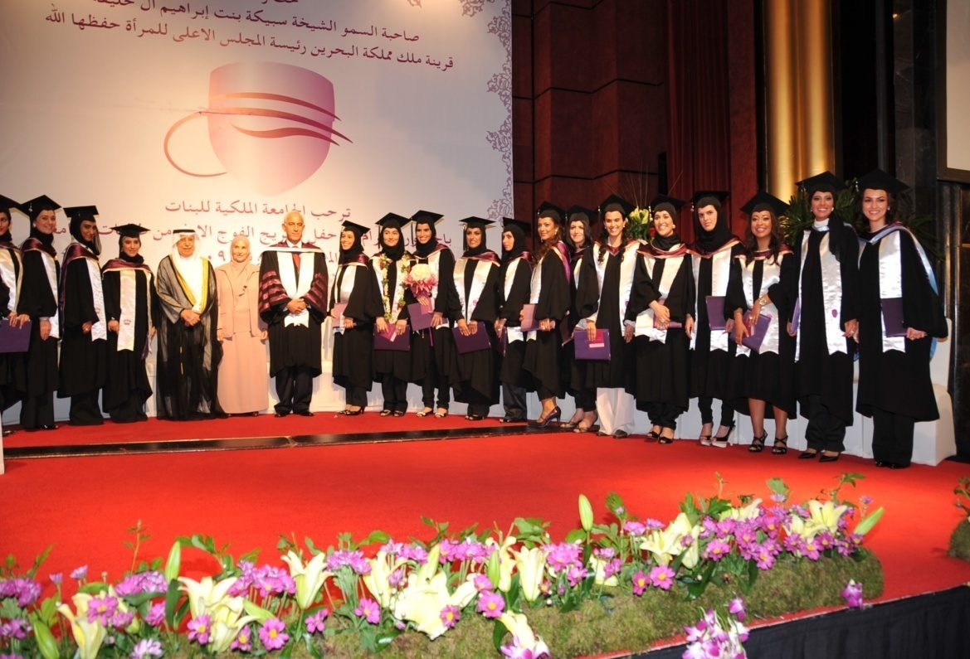
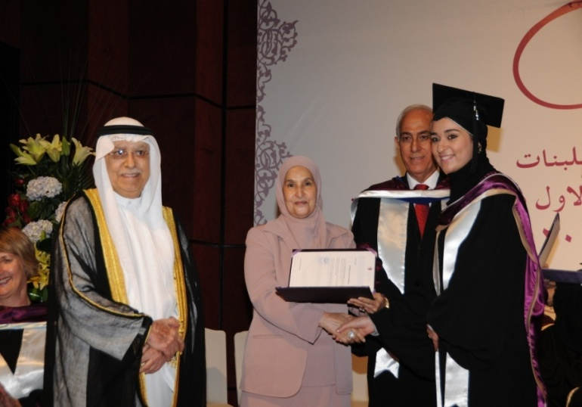
Class of 2009

Slide 9
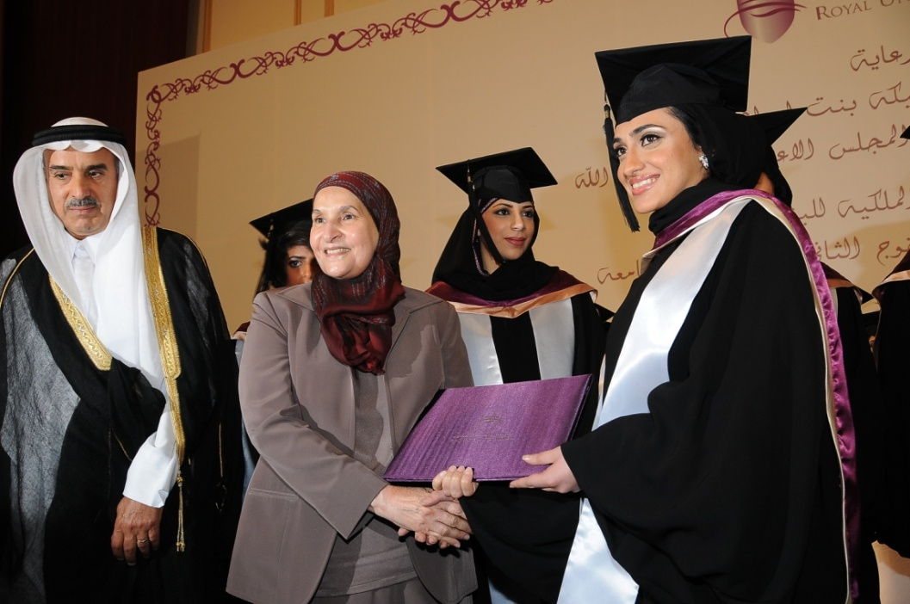
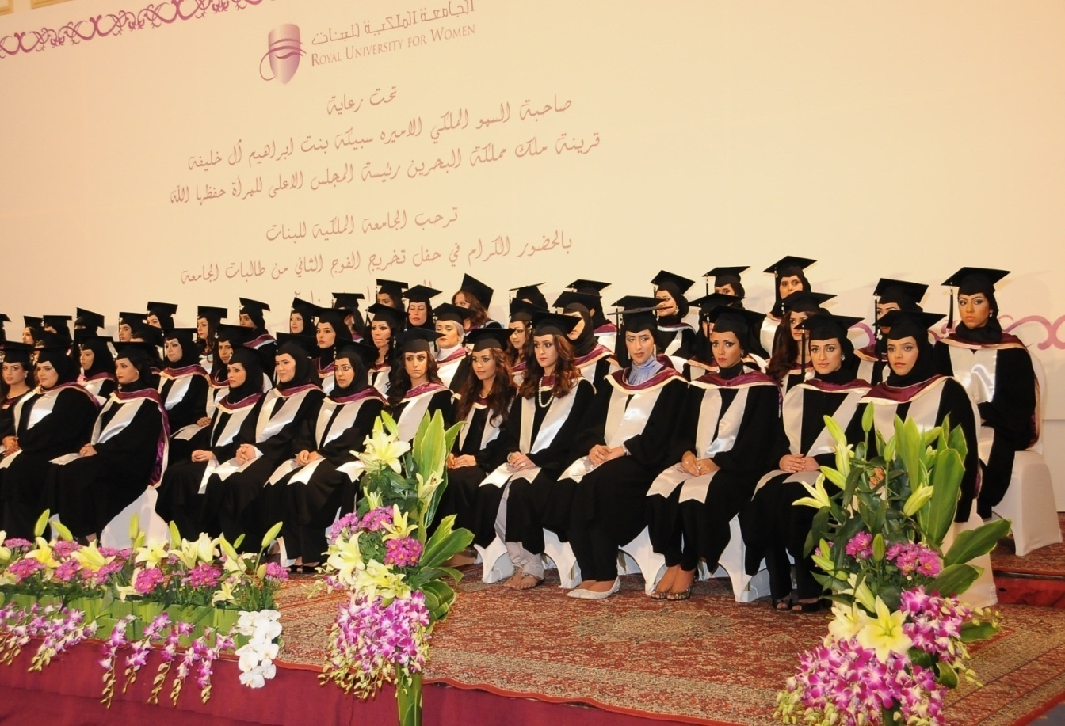
Class of 2010

Slide 10
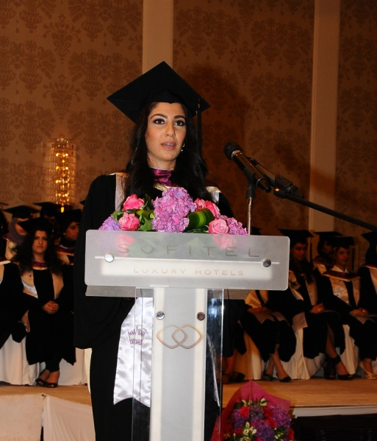
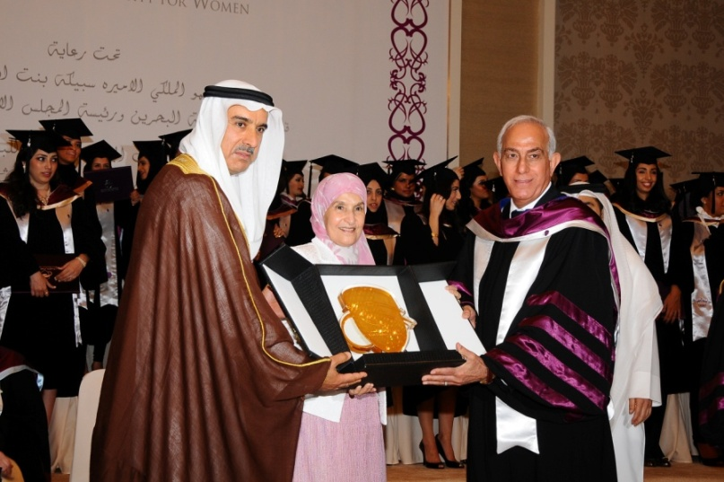
Class of 2011

Slide 11
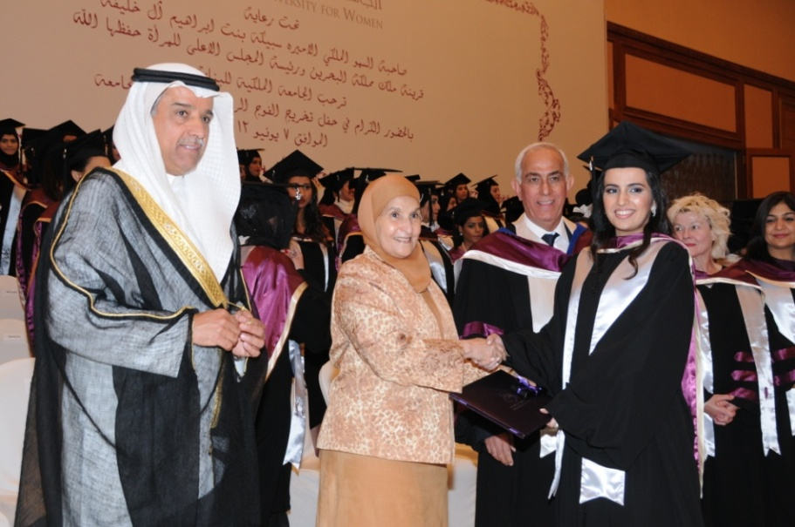
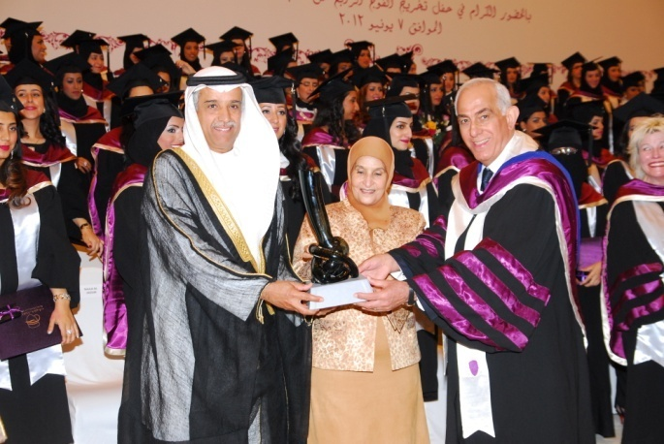
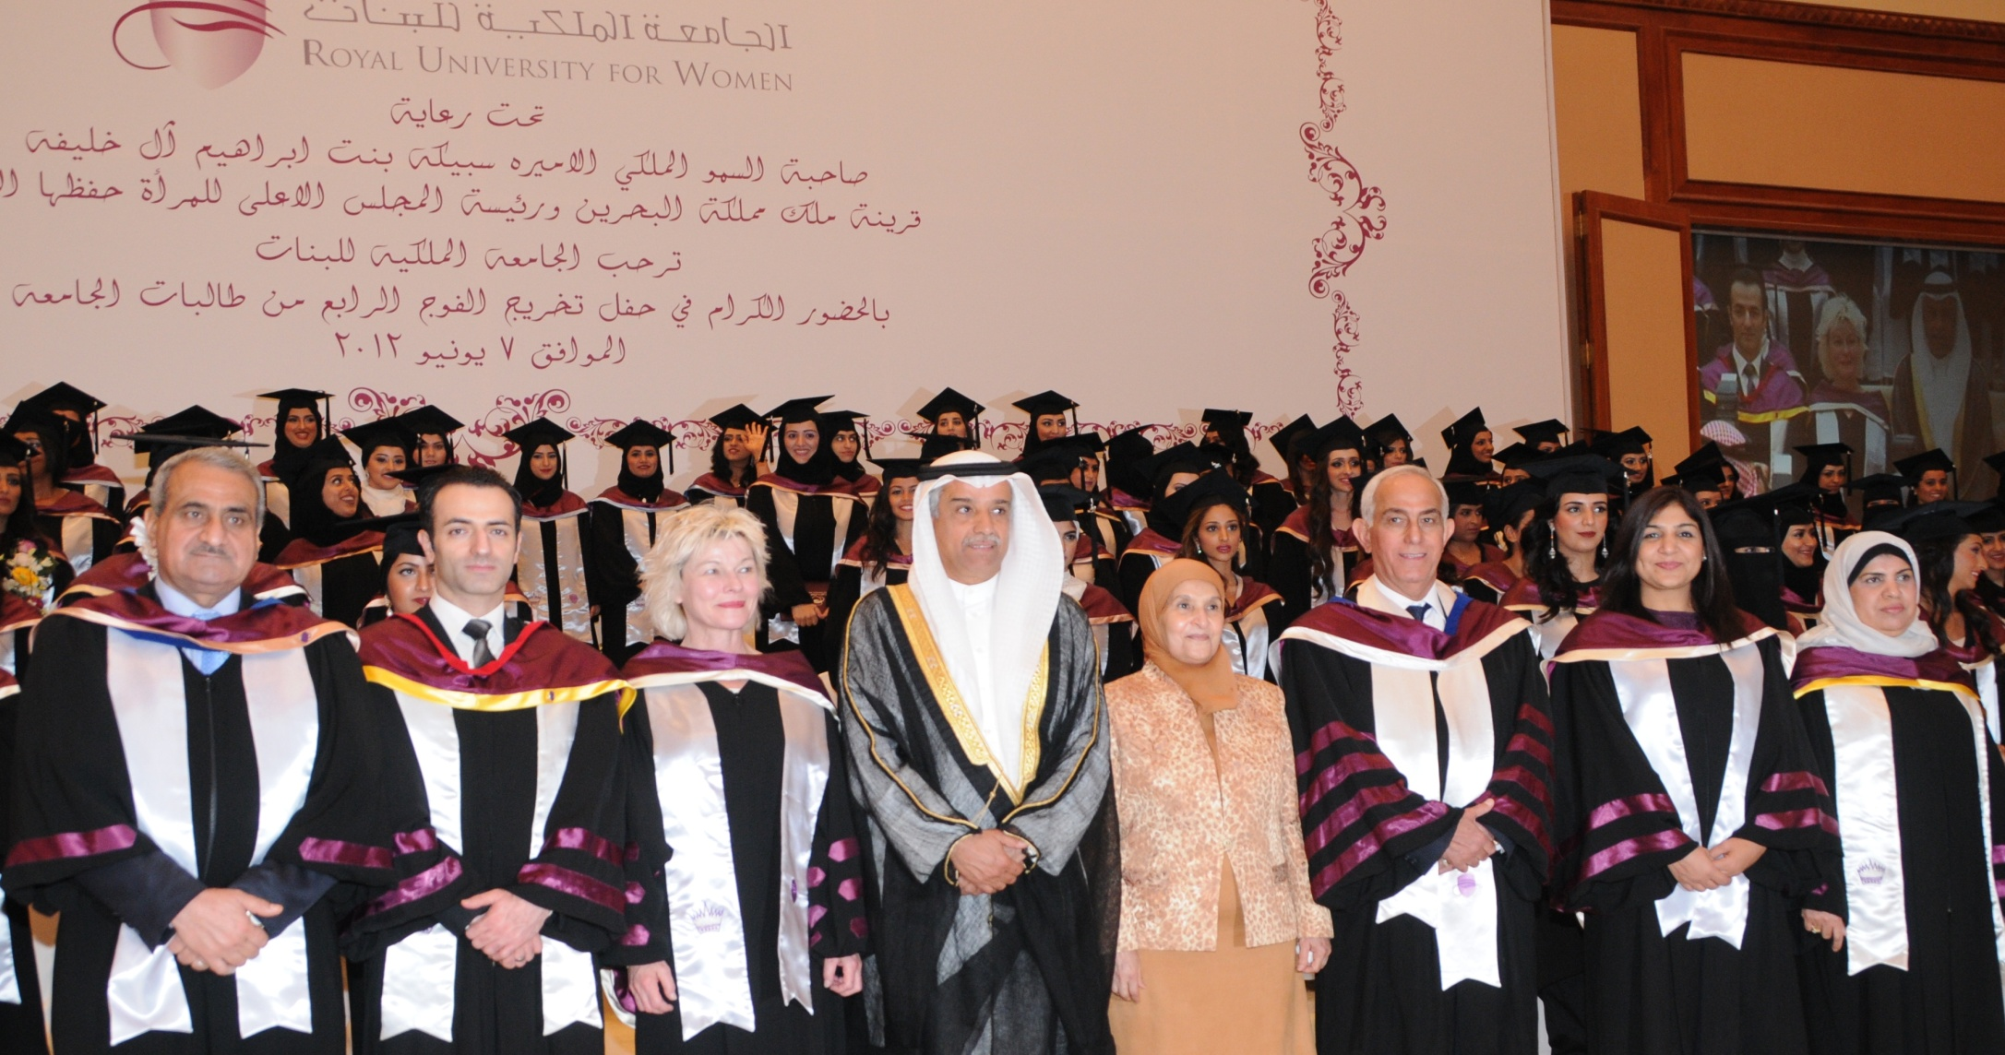
Class of 2012

Slide 12
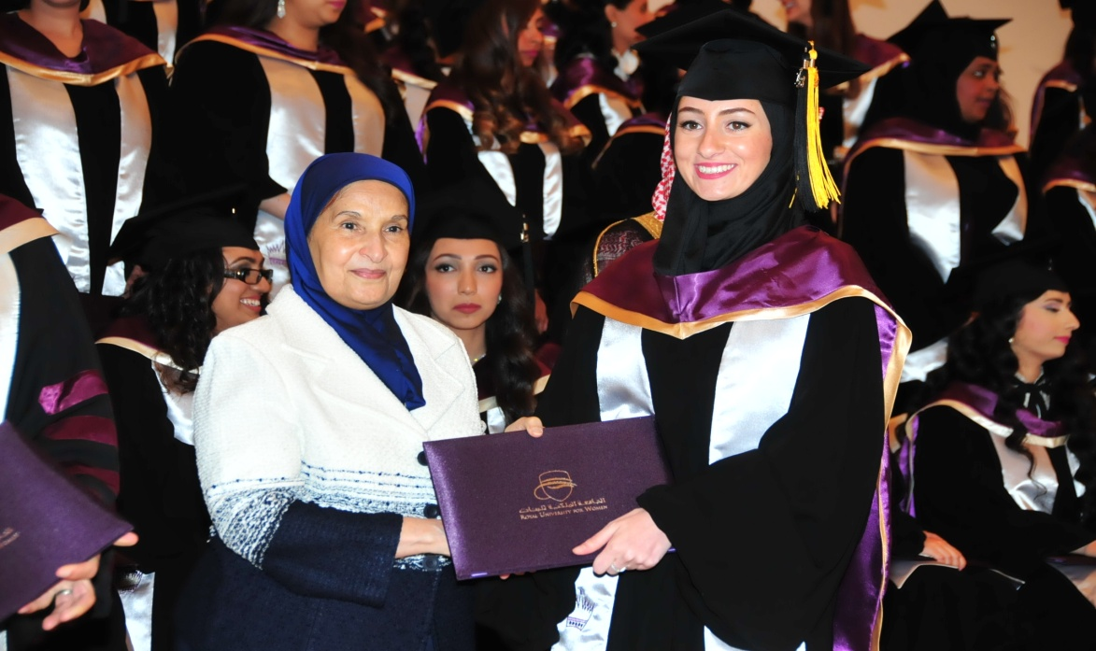
Class of 2013

Slide 13
Class of 2014

Slide 14
Class of 2015

Slide 15
Thank You

